Slide 1


SMART INDIA HACKATHON 2024
NAYI DISHA
Problem Statement ID: 1632
Problem Statement Title: An interactive job and internship platform for Technical Education Department, Govt. of Rajasthan.
Theme: Smart Education
PS Category: Software
Team ID:
Team Name: NAYI DISHA

Slide 2
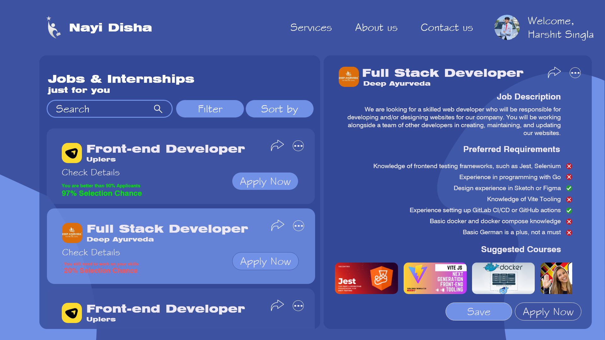
Career Guidance through AI Matchmaking
NAYI DISHA
Resume analysis
Evaluate job readiness
Tailored learning path

Slide 3
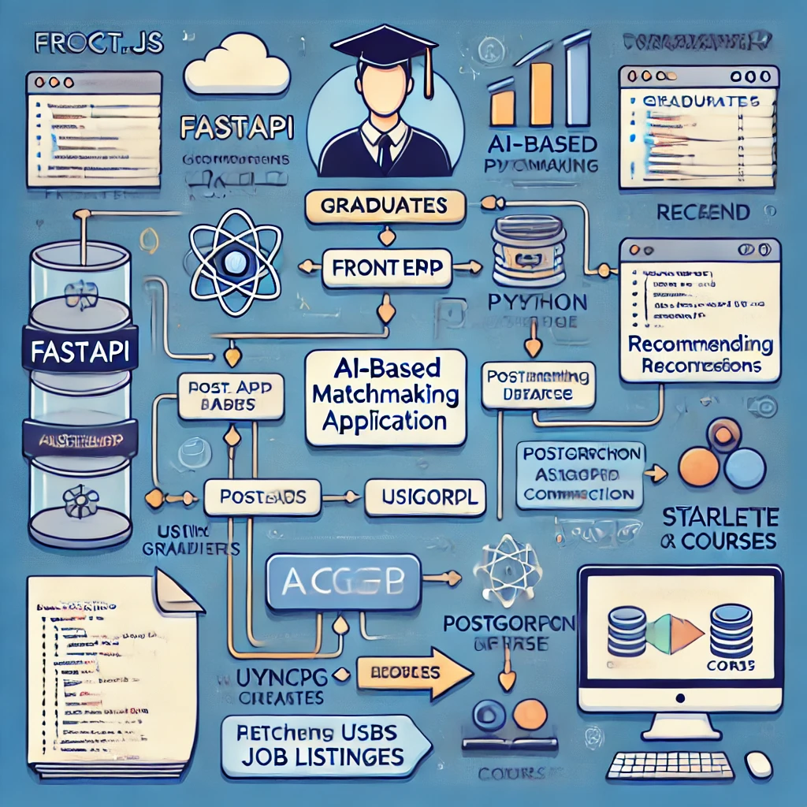
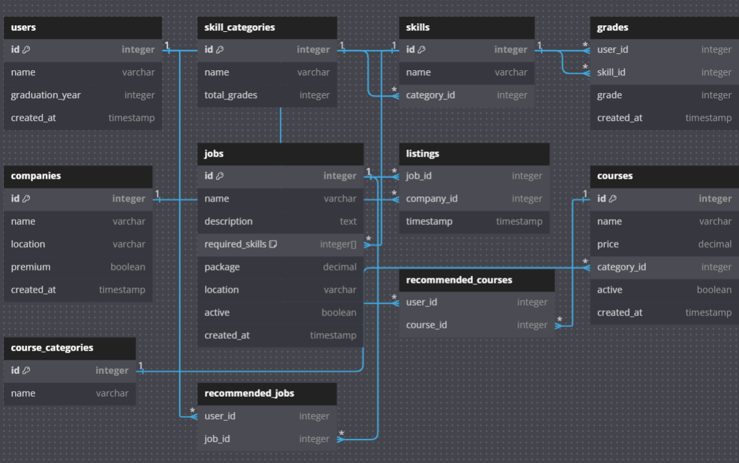




Technical Approach
NAYI DISHA
Full stack Application
Database Design
Reactjs Frontend (Javascript)
FastApi Backend (Python) - Starlette Middleware
Postgresql Database
Built asynchronously and fully scalable on the ASGI interface.

Slide 4
NAYI DISHA
Impact And Benefits
Sponsored job listings that show up at the top of the job list for graduates.
Holding AI-proctored examinations within the site itself for companies to select candidates at a premium fee.
Resume and cover letter consultations with our trained and experienced hiring professionals.
Sponsored courses which show up at the top of personalised recommended courses for graduates.
Referral fee from purchase of courses by graduates for any paid course.
Non-premium
In non-premium, job openings lists will have limited openings (per month approx. 3-4)
Reach is limited to 45% of the best candidates.
Premium
With Premium, job openings lists will have upto 20 openings per month. Reach is maximized to 90% of the best candidates.

Slide 5
RESEARCH AND REFERENCES
NAYI DISHA
General resources:
International Labor Organisation: https://www.ilo.org/
Job boards:
Indeed: https://www.indeed.jobs/
Linkedin: https://www.linkedin.com/
Internshala: https://www.internshala.com/
Courses:
Coursera: https://www.coursera.org
Career counseling:
National Career Service: https://www.ncs.gov.in/

